Slide 1
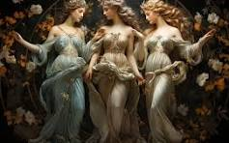
HIS Saving GRACE
Ephesians 2: 1 -12
The Graces
Joy
Elegance
Beauty

Slide 2
The Saviour’s Grace
HIS Saving GRACE
Grace is a beautiful word
Grace is a wonderful gift
Christ’s grace is even better and it’s inexhaustible- (2 Corinthians 8:9; 9:8; 13:13)

Slide 3
Grace in Ephesians
Ephesians 2: 1 -12
HIS Saving GRACE
“The brackets” - Ephesians 1:2 & 6:24
“Lavish grace” - Ephesians 1: 7
“Glorious grace” - Ephesians 1: 6

Slide 4
Saving Grace
Ephesians 2: 1 -12
HIS Saving GRACE
Ephesians 2: 5 -8
“It is by grace you have been saved…
God who is rich in mercy….raised us up with Christ in order that…he might show the incomparable riches of his grace
For it is by grace you have been saved, through faith…it is the gift of God - not of works”
“The Prodigal Son

Slide 5
Saving Grace -
Ephesians 2: 1 -12
HIS Saving GRACE
Saved from what?
Ephesians 2: 5 -8
“It is by grace you have been saved…
DEAD - in trespasses and sins
CAPTIVES - to evil spiritual forces
- to our selfish cravings
CONDEMNED - “by nature objects of wrath”

Slide 6
Saving Grace -Incomparable riches!
HIS Saving GRACE
Ephesians 2: 1 -12
Ephesians 2: 5 -8
God who is rich in mercy….raised us up with Christ in order that…he might show the incomparable riches of his grace
“Love…rich in mercy… his grace”
Death…powers of darkness… depraved culture… human nature
“Where sin increased, grace increased all the more” (Romans 5: 20) - impact (overflow)…extent (the many) …eternal life (quality)

Slide 7
Saving Grace - The contrast
HIS Saving GRACE
Ephesians 2: 1 -12
For it is by grace you have been saved, through faith…it is the gift of God - not of works”
Not of works …Human achievement, endeavour, effort, righteousness, status, merit, approval, reward
“Not from yourselves” …our plan, our initiative, our innate ability
The gift of God … freely, relational, freeing

Slide 8
Grace in Ephesians
HIS Saving GRACE
Ephesians 2: 1 -12
The Prodigal Son
Deserved - degradation, starvation, isolation
Hoped for - mercy - accepted as a servant
Received - incomparable grace - welcome, honour, restoration, sonship
Healing - the past, the present and the future

Slide 9
The future
HIS Saving GRACE
Ephesians 2: 1 -12
Paul’s Life
Damascus Road
Visit of Ananias
“My chosen instrument…”
“By the grace of God, I am what I am, and his grace to me was not without effect…”
(1 Corinthians 15:10)

Slide 10
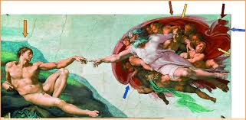
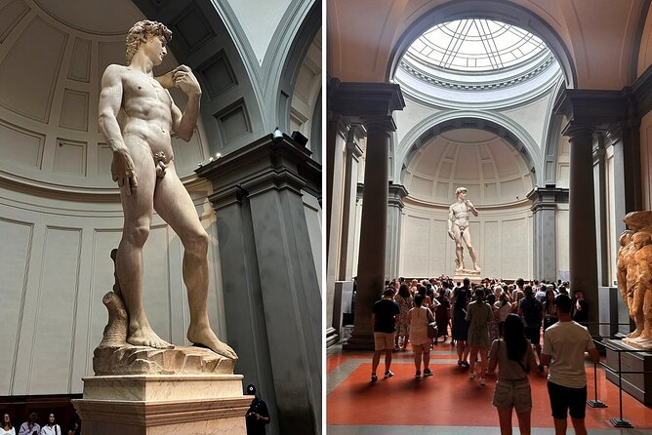
Michael Angelo
Ephesians 2: 1 -12
HIS Saving GRACE
“I saw the angel in the marble and carved until I set him free”

Slide 11
Saving Grace
Ephesians 2: 1 -12
HIS Saving GRACE
Serving Grace
God’s workmanship
Created in Christ Jesus
To do good works
According to God’s plan

Slide 12
Grace in Ephesians
Ephesians 2: 1 -12
HIS Saving GRACE
“Gift of God’s grace” -
To Paul - Ephesians 3: 2, 7 -8
To All - Ephesians - 4: 7

Slide 13
Saving Grace
HIS Saving GRACE
Ephesians 2: 1 -12
“How marvellous, how wonderful!”
Do I know this grace?
Can I share this grace?
Will I live this grace?
?

